Slide 1




§3.3 MLBD MRes practical
From a single neuron to the multilayer perceptron
Colour swatch
Patrick Dunne
Material for this week developed by Jarvist Moore Frost
Styles + Sizes: (by Golden Ratio)
36 for large headline, Montserrat
22 for big text / small headlines, Questrial (Futura like)
14 for small text, Questrial
9 (8.5) for smaller text, Questrial
36 Montserrat - SemiBold
22 Questrial big text // 22 Montserrat - SemiBold (small headings)
14 for small text, Questrial
9 (8.5) for smaller text, Questrial
Colour swatch

Slide 2
Intended Learning Outcomes
Demonstrate how multilayer perceptrons are built, by building a network and solving a task within PyTorch.
Be able to summarise what we learnt in the first session. (Taught from these slides)
Reimplement a single neuron binary classifier in PyTorch. (Jupyter)
Be aware of the mathematics of backpropagation, the multi-layer learning algorithm. (Jupyter)
Use a multilayer perceptron to solve a nonlinear task. (Jupyter)
Run well defined machine-learning experiments to explore and document the parameter space of model construction and learning, communicating progress with your peers. (Jupyter)

Slide 3
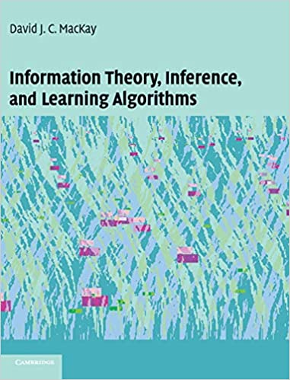
Recommended reading
David MacKay, Information Theory, Inference and Learning Algorithms (ITILA), 2003, Chapters 38–42.
Freely available online!
A physicists perspective on ML.
http://www.inference.org.uk/mackay/itila/book.html
These slides and classworks follow some of the structure of Chapter 38 & 39.

Slide 4
§3.2 Practical
Add missing code:
  Sigmoid activation function
  Neuron function
  Training loop
You can now train a model & visualise the decision boundary!
  Document how the training performs, with different training rates ('eta') and weight decay ('alpha)
  Compare training with a simple linear classifier
  How does the neuron fair on the more difficult Gaussian dataset?
Advanced concepts
  Change the activation function. (Think about the gradients.)
  Often neural networks have an additional 'bias' input. Add this to your code.
  Batch training - currently all data is used to build the single gradient.
  What happens if you try and use the method for regression (against a function)?
  Can you improve the regression performance by adding extra neurons side-by-side, each fitting a different part of the function?
Suggested homework / self-study
  David MacKay, Information Theory, Inference and Learning Algorithms (ITILA), 2003, Chapters 38–42.
  PyTorch '60 minute Blitz' https://pytorch.org/tutorials/beginner/deep_learning_60min_blitz.html

Slide 5
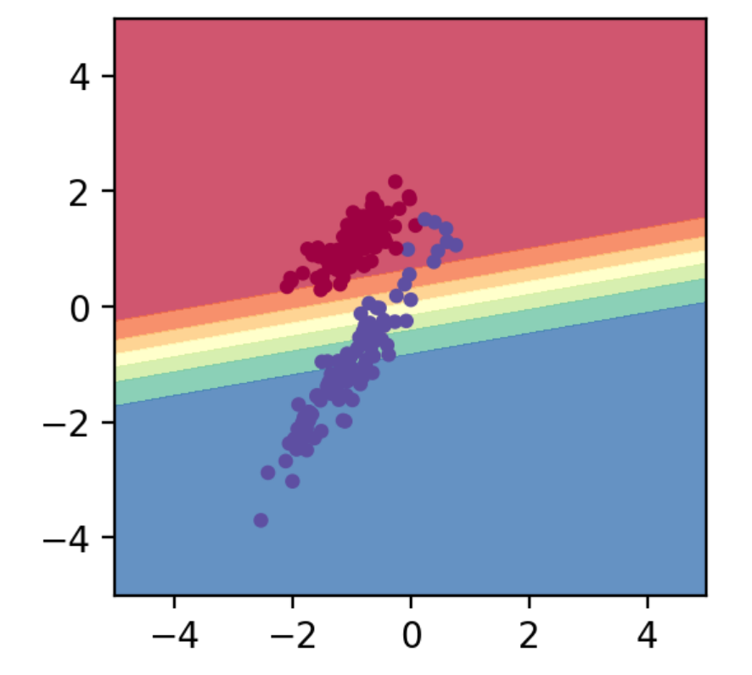
Decision boundary visualisation

Slide 6
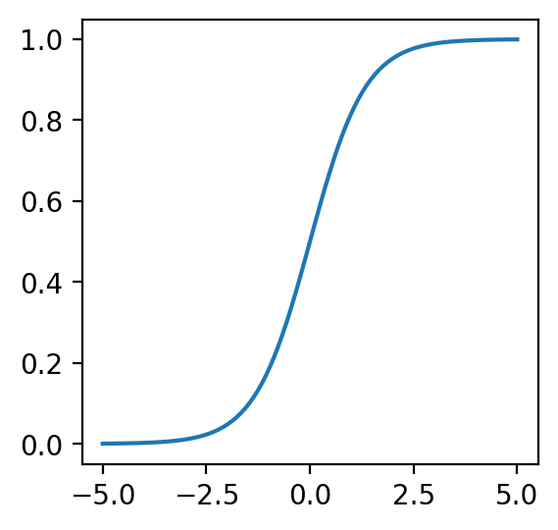
MODEL SAYS NO
MODEL UNCERTAIN
MODEL SAYS YES
Decision boundary visualisation

Slide 7
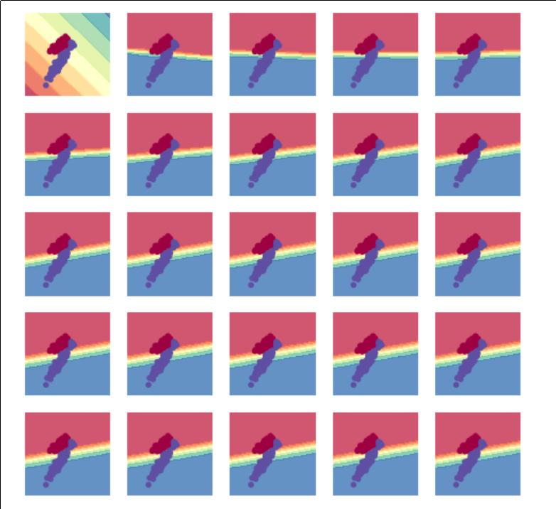

Slide 8
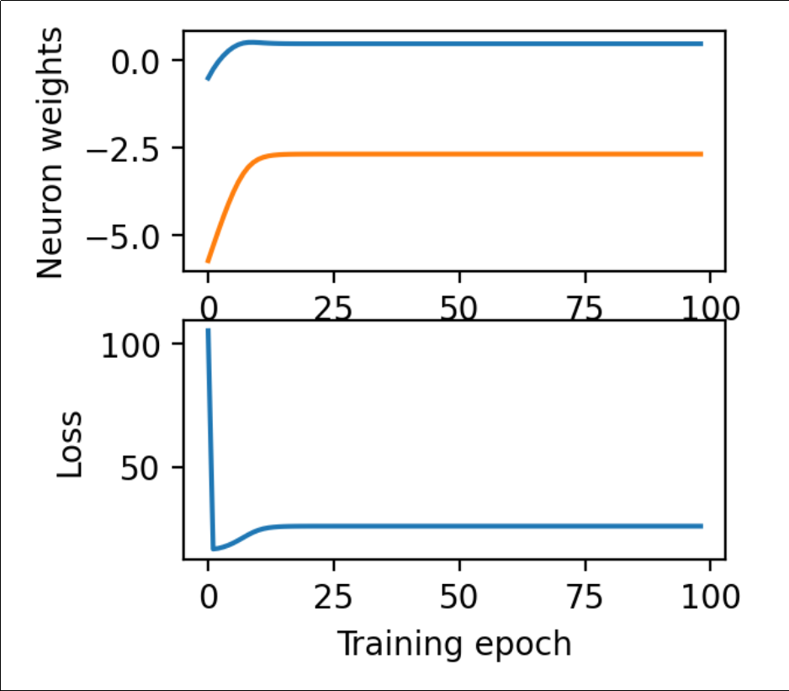
'Learning curves'

Slide 9
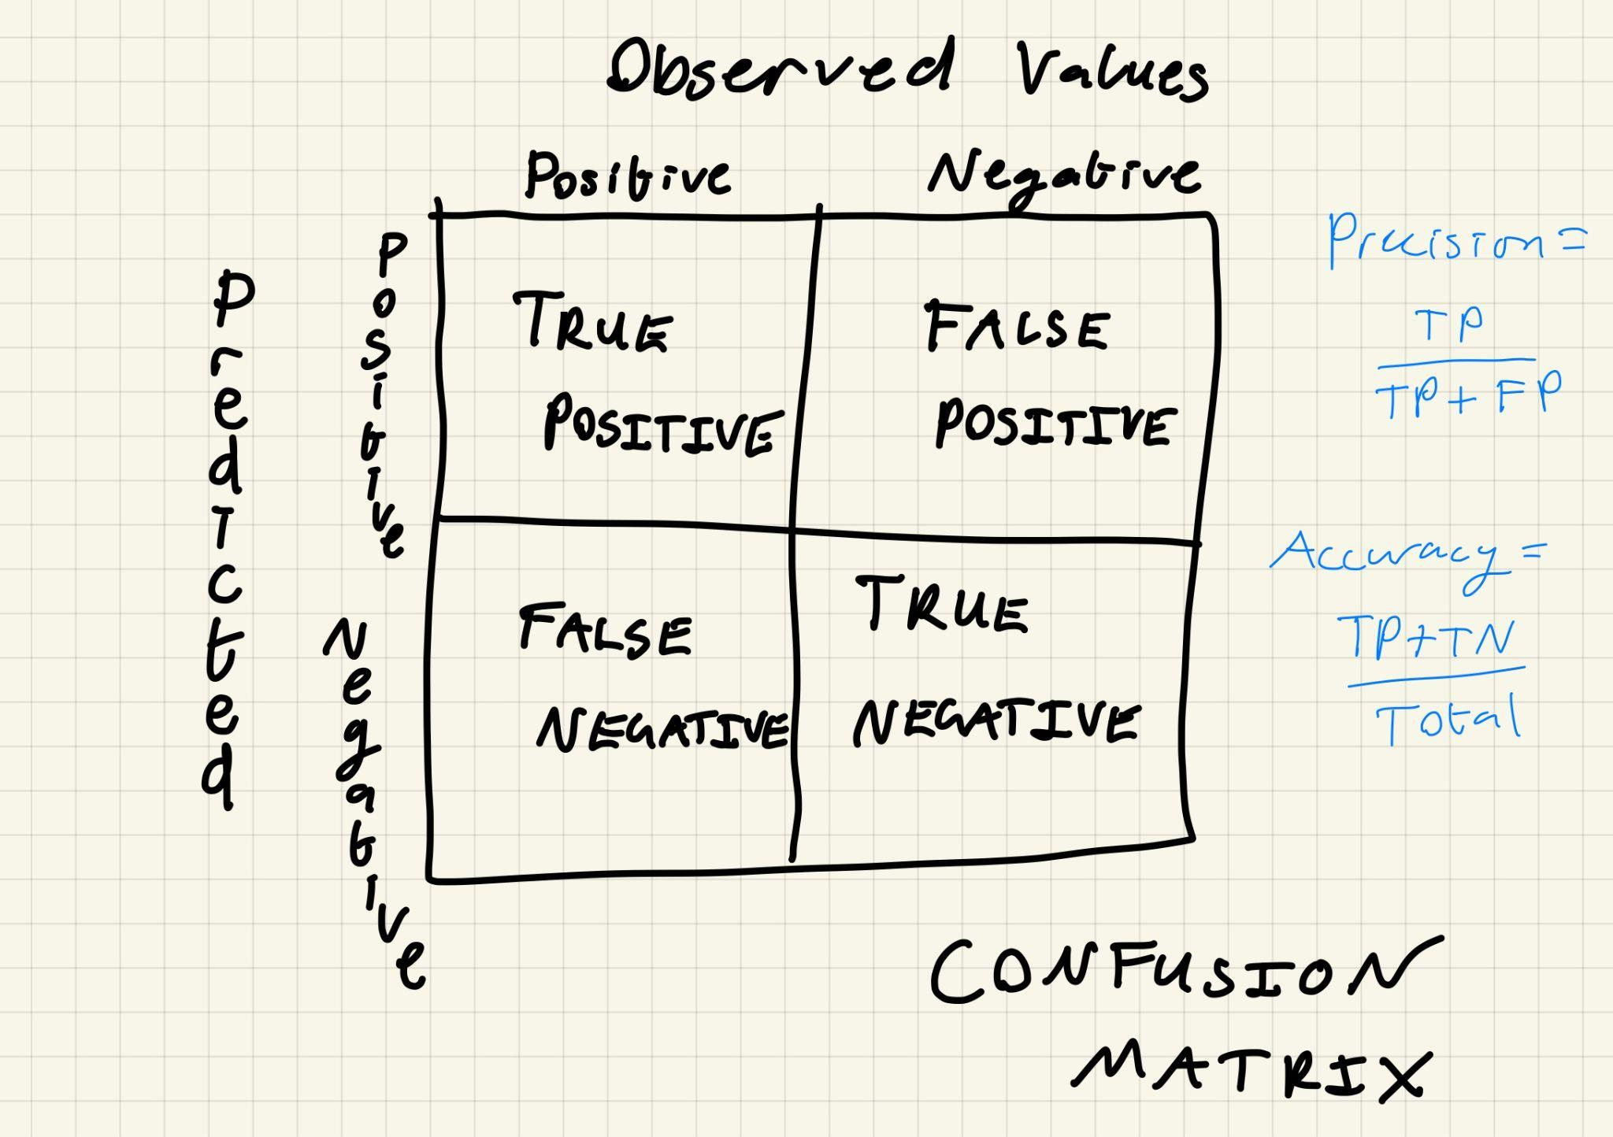

Slide 10
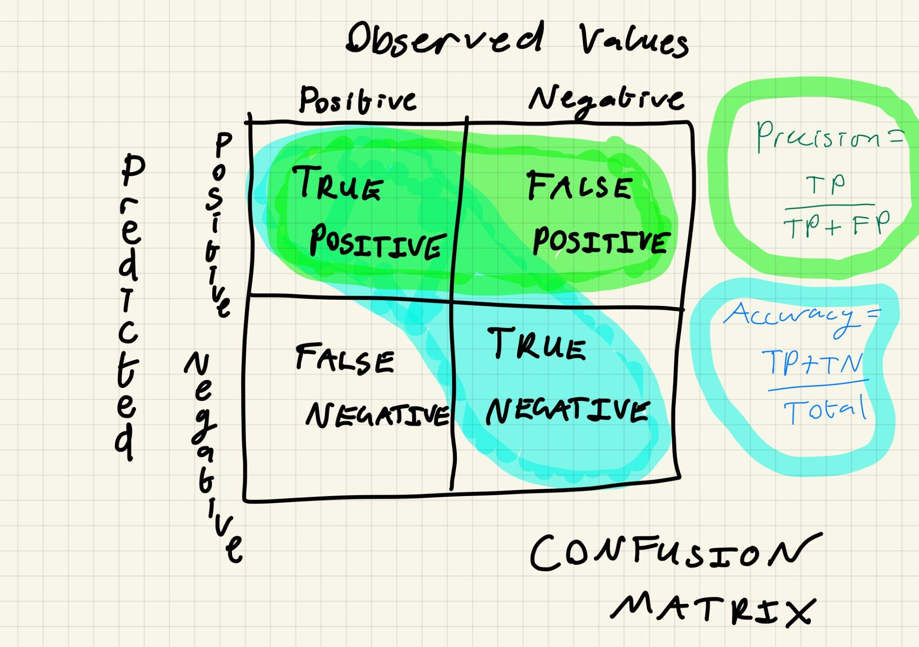

Slide 11
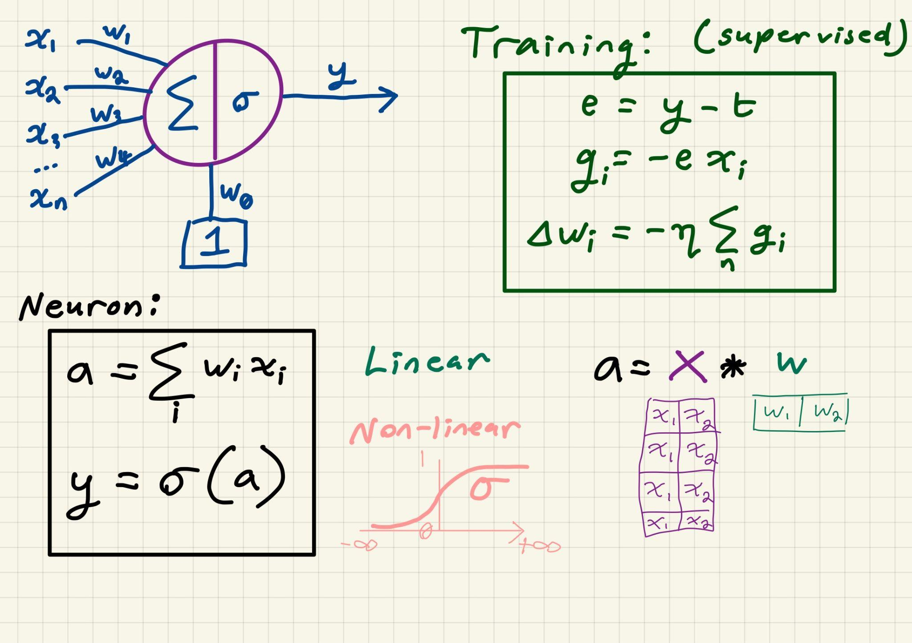
Single neuron by hand. No magic involved!

Slide 12
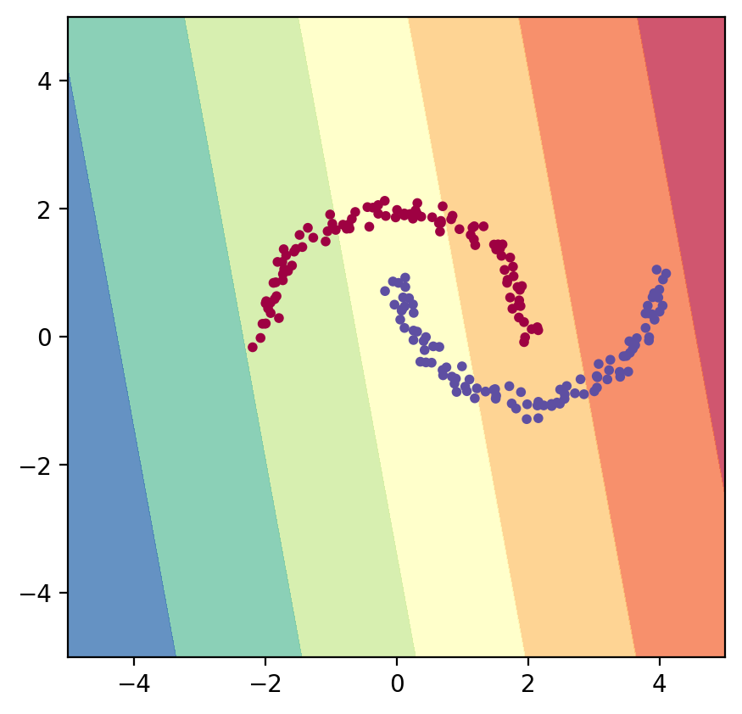

Slide 13


Slide 14
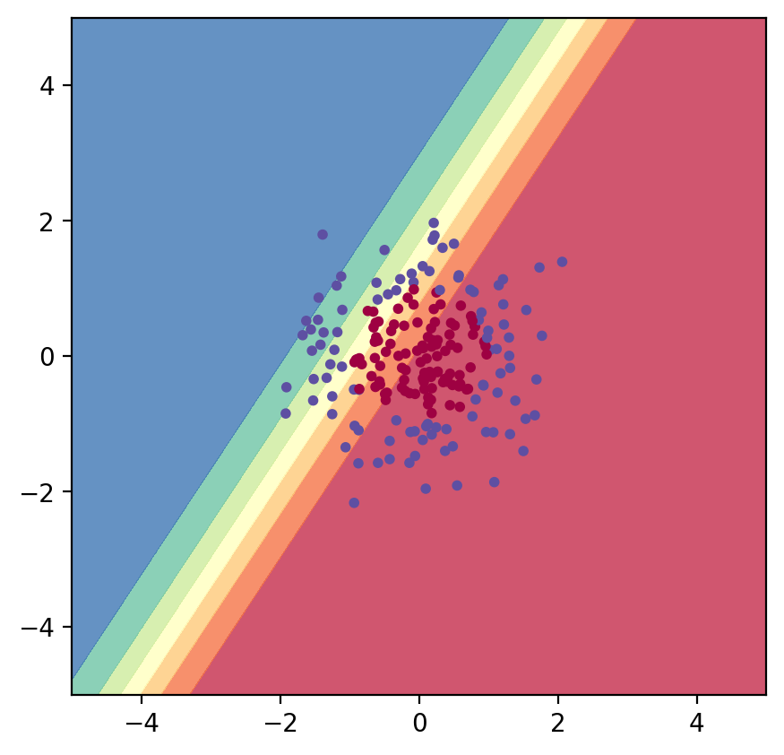
Similarly poor on overlapping Gaussians…

Slide 15
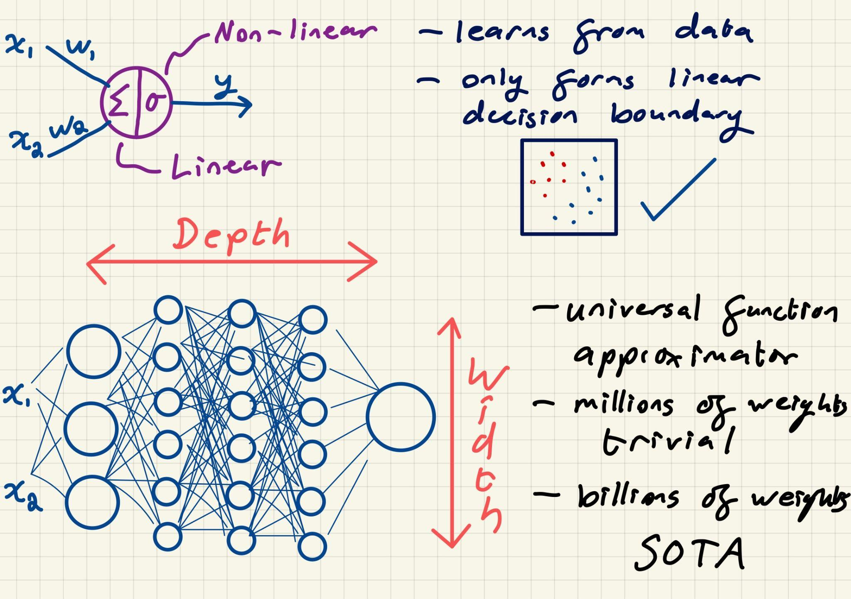
Magic comes from emergent behaviour…

Slide 16
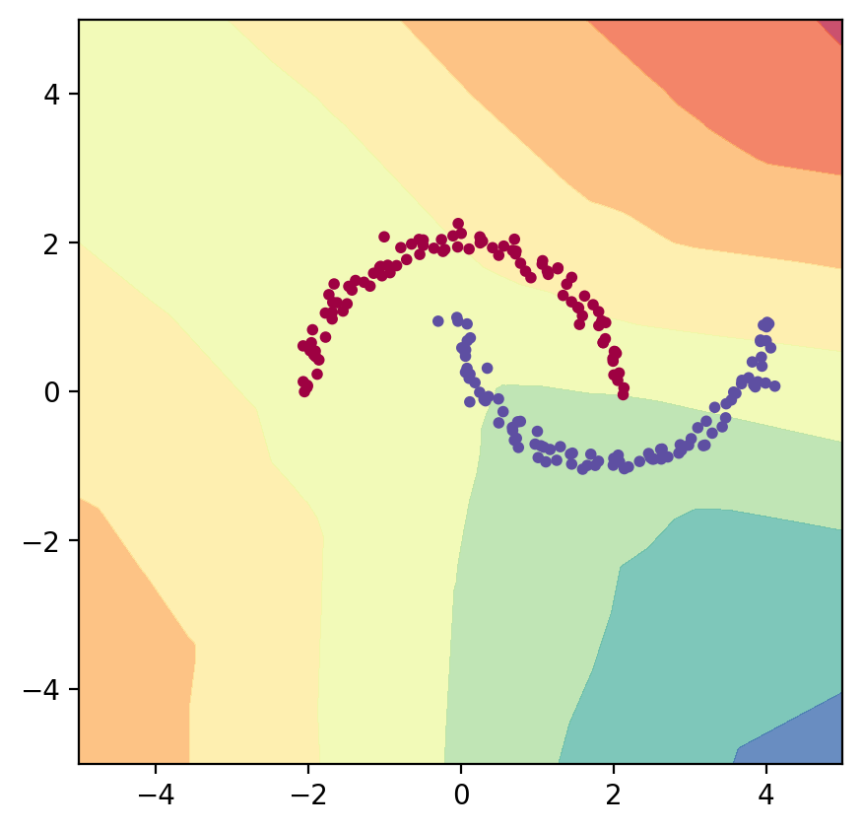
Multilayer perceptron: 2=>40, ReLU; 40=> 1, Sigmoid
Training by back propagation (G.Hinton 1986)
Rumelhart, D., Hinton, G. & Williams, R. Learning representations by back-propagating errors. Nature 323, 533–536 (1986). https://doi.org/10.1038/323533a0

Slide 17
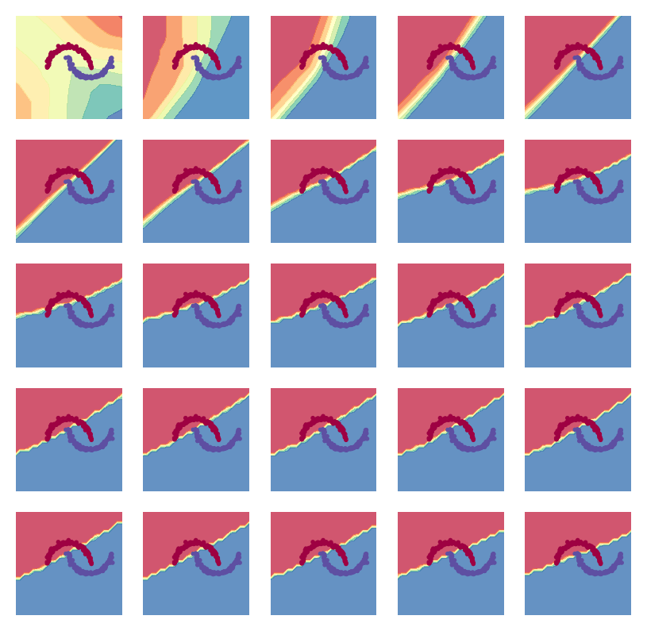

Slide 18
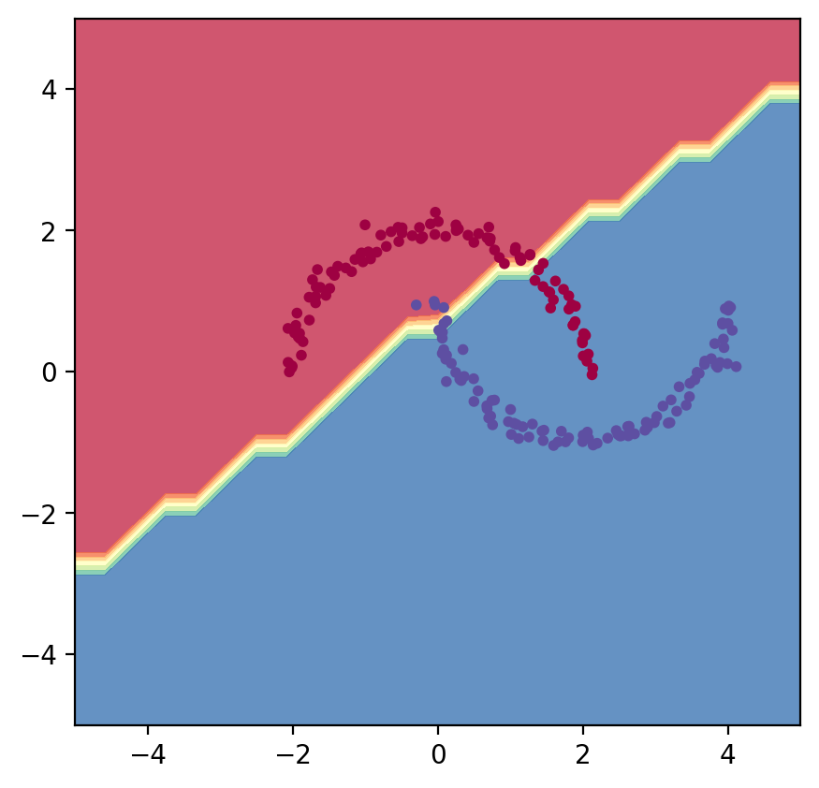
OK! Solution not so good (accuracy = 35%?)
But non-linear, and interesting wiggles

Slide 19
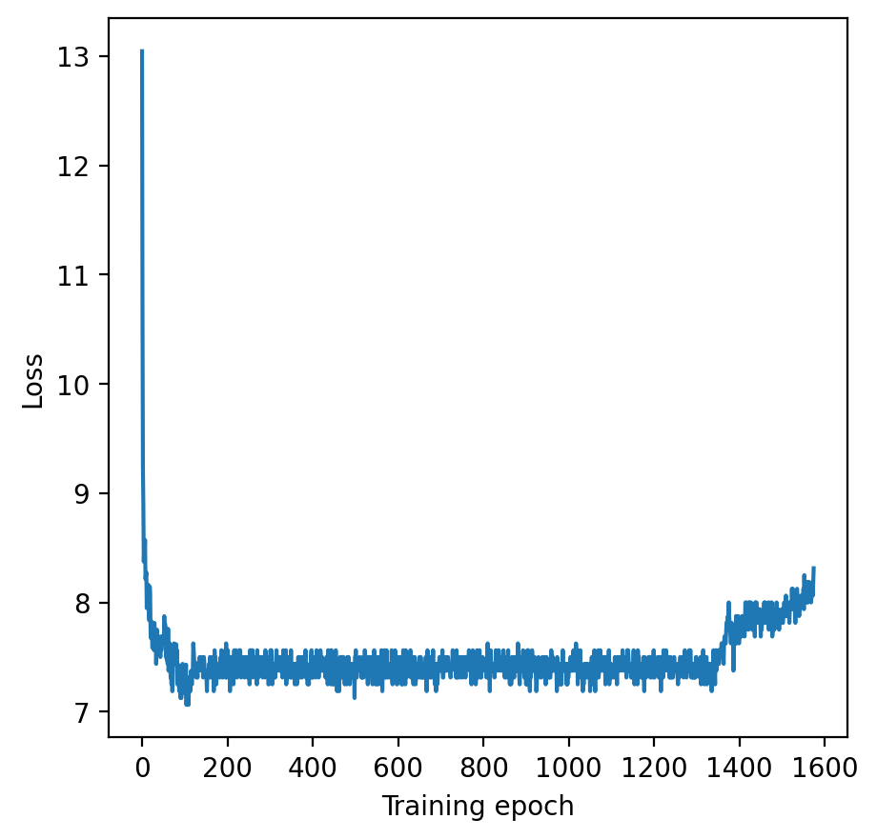
Let's look at here…
Early stopping
Training is highly empirical; can take a long time.

Slide 20
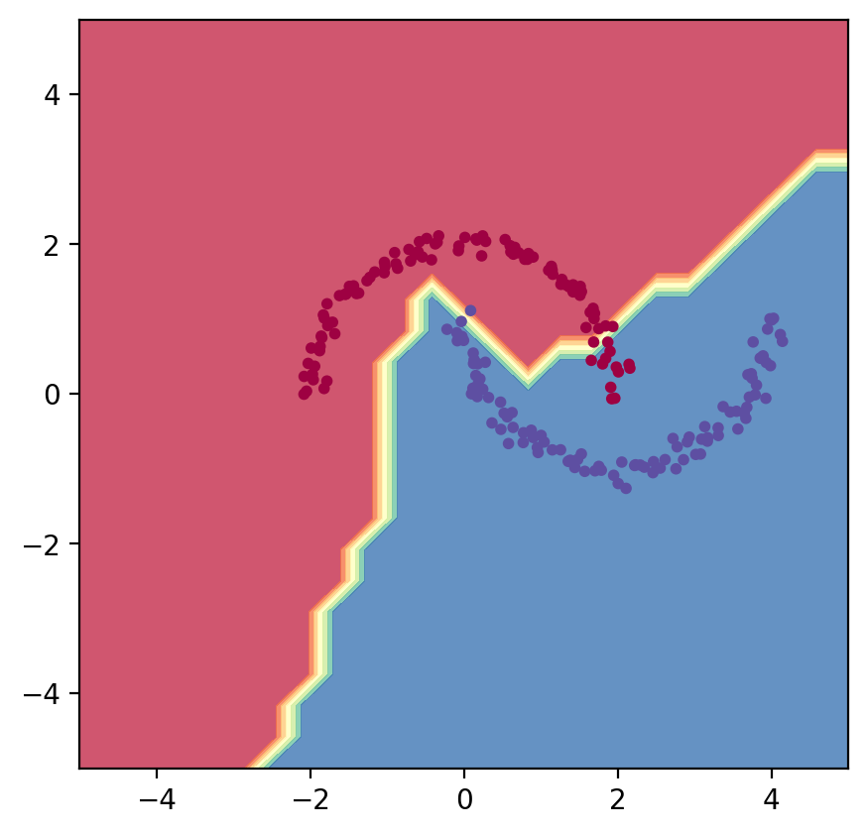

Slide 21
§3.3 Practical
Add missing (PyTorch!) code:
  Rebuild a single neuron in Pytorch
    Layers, loss function
    accuracy function: true positives + true negatives / total
  Multilayer Perceptron
    Define architecture; define loss function
Single neuron experiments - now with PyTorch
  Change the activation function. (Think about the gradients.)
  What effect does the bias have?
  Set the weights by hand, and document the decision boundary.
Multi-layer perceptron experiments - with PyTorch
  Experiment with model construction, task, learning parameters, etc.
    Document as you go! (Jupyter is really bad for this.)
    Scoreboard for highest accuracy against each task:
      Moons
      Gaussians
      Your own challenge here?
Extend PyTorch code to Regression
  What happens if you try and use the method for regression (against a function)?
    Collect data points from a function, and fit over a range, i.e.
      y=sin(x) ; y=x ; y=x^2 ; y=sinh(x)
  Can you improve the regression performance by adding extra neurons side-by-side, each fitting a different part of the function?
  Compare regression to Gaussian processes: https://jarvist.github.io/2021-PhysicsMachineLearningPracticum/02_GaussianProcessPotentialEnergySurface.html

